Slide 1
COMP5523 Lab 1
Canny Edge Detector

Slide 2
COMP5523 Lab 1
Part 2 Canny detector by Python

Slide 3
Outline
Python tutorial
Code environment
Canny recap
Hough line detection (optional)
Administrative details
Lab report
Grading

Slide 4

For beginners:
Build in data structures:
set, array, etc.
Class
Numpy, matplotlib
http://cs231n.github.io/python-numpy-tutorial/

Slide 5


Code Environment
Best practice: anoconda + pycharm

Slide 6
Canny Step by Step
1. Smoothing (np.flip)
2. Finding gradients (np.arctan2 & np.rad2deg)
3. Non-maximum suppression (rounded direction)
4. Double thresholding
5. Edge tracking by hysterisis

Slide 7
Hough Step by Step
Extract edges of the image using Canny
1- initialize parameter space rs, thetas
2- Create accumulator array and initialize to zero
3- for each edge pixel
4- for each theta (-90, 90)
5- calculate r = x cos(theta) + y sin(theta)
6- Increment accumulator at r, theta
7- Find Maximum values in accumulator (lines)
Extract related r, theta

Slide 8
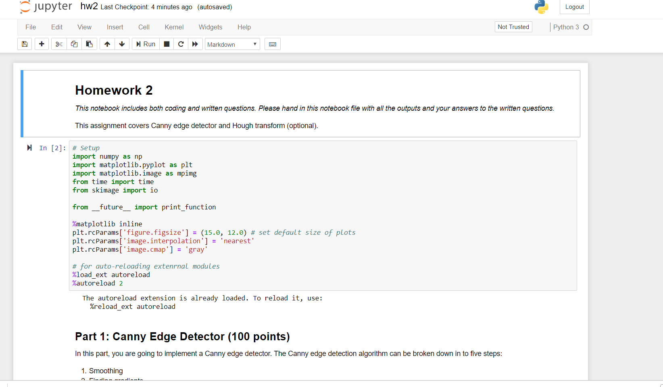
How is our lab report organized?
You are supposed to demonstrate your results on a python notebook, i.e., a .ipynb file.
Grading points are listed in the notebook.
If you want to share more, pls use an additional pdf to encompass them.

Slide 9
Due March 29 at 23:59 pm

